Slide 1
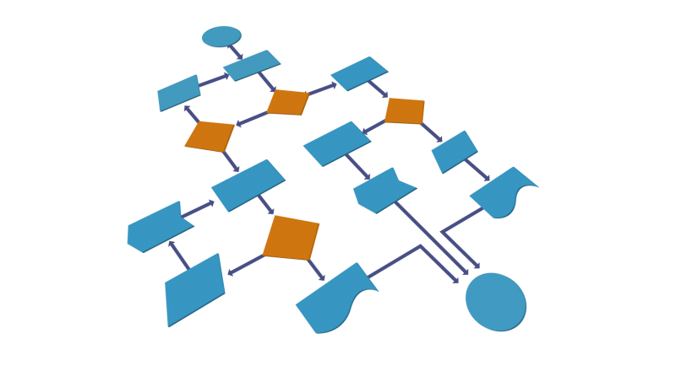


C# Auto Mapping Objects
Manual Mapping
and AutoMapper Library
SoftUni Team
Technical Trainers
Software University
http://softuni.bg

Slide 2
Table of Contents
DTO Definition
Manual Mapping
AutoMapper

Slide 3
Questions
sli.do #CSharpDB

Slide 4
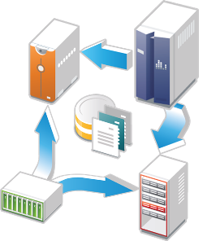
Data Transfer Objects
Definition and Usage

Slide 5
What is a Data Transfer Object?
A DTO is an object that carries data between processes
Used to aggregate only the needed information in a single call
Example: In web applications, between the server and client
Doesn't contain any logic – only stores values
public class ProductDTO
{
public string Name { get; set; }
public int StockQty { get; set; }
}

Slide 6
DTO Usage Scenarios
Remove circular references
Hide particular properties that clients are not supposed to view
Omit some properties in order to reduce payload size
Flatten object graphs that contain nested objects to make them more convenient for clients
Decouple your service layer from your database layer

Slide 7
Manual Mapping
Relationship Diagram
Product
Storage
ProductId
Name
Description
StorageId
Name
Location
ProductStock
Quantity
ProductId
StorageId
Additional data
in mapping table

Slide 8
Manual Mapping (2)
Get product name and stock quantity in a new DTO object
var product = context.Products.FirstOrDefault();
var productDto = new ProductDTO
{
Name = product.Name,
StockQty = product.ProductStocks
.Sum(ps => ps.Quantity)
};
Aggregate information from mapping table

Slide 9

AutoMapper Library
Automatic Translation of Domain Objects

Slide 10
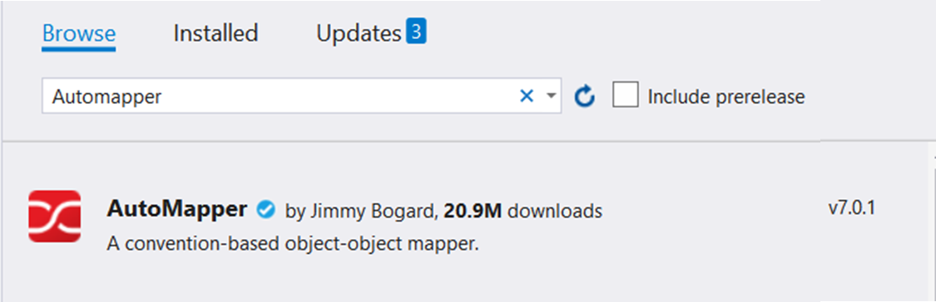
What is AutoMapper?
Library to eliminate manual mapping code
Available as a NuGet Package
Official GitHub Page
Install-Package AutoMapper

Slide 11
Initialization and Configuration
AutoMapper offers a static service for use and configuration
Add mappings between objects and DTOs
Properties will be mapped by name
Source
Mapper.Initialize(cfg => cfg.CreateMap<Product, ProductDTO>());
Target
var product = context.Products.FirstOrDefault();
ProductDTO dto = Mapper.Map<ProductDTO>(product);

Slide 12
Multiple Mappings
You can configure all mapping configurations at once
Mapper.Initialize(cfg =>
{
cfg.CreateMap<Product, ProductDTO>();
cfg.CreateMap<Order, OrderDTO>();
cfg.CreateMap<Client, ClientDTO>();
cfg.CreateMap<SupportTicket, TicketDTO>();
});

Slide 13
Custom Member Mapping
Map properties that don't match naming convention
Destination property
Mapper.Initialize(cfg =>
cfg.CreateMap<Product, ProductDTO>()
.ForMember(dto => dto.StockQty,
opt => opt.MapFrom(src =>
src.ProductStocks.Sum(p => p.Quantity))));
Source

Slide 14
Flattening Complex Properties
AutoMapper can also be used to flatten complex properties
Mapper.Initialize(cfg =>
cfg.CreateMap<Event, CalendarEventViewModel>()
.ForMember(dest => dest.Date,
opt => opt.MapFrom(src => src.Date.Date))
.ForMember(dest => dest.Hour,
opt => opt.MapFrom(src => src.Date.Hour))
.ForMember(dest => dest.Minute,
opt => opt.MapFrom(src => src.Date.Minute)));

Slide 15
Flattening Complex Objects
Flattening of related objects is automatically supported
AutoMapper understands ClientName is the Name of a Client
public class OrderDTO
{
public string ClientName { get; set; }
public decimal Total { get; set; }
}
Mapper.Initialize(cfg => cfg.CreateMap<Order, OrderDTO>());
OrderDTO dto = Mapper.Map<Order, OrderDTO>(order);

Slide 16
Unflattening Complex Objects
Unflattening of related objects is automatically supported
AutoMapper understands ClientName is the Name of a Client, but to unflatten it, it needs ReverseMap
public class OrderDTO
{
public string ClientName { get; set; }
public decimal Total { get; set; }
}
Mapper
.Initialize(cfg => cfg.CreateMap<Order, OrderDTO>()
.ReverseMap());

Slide 17
Nested Mapping
AutoMapper uses another type map, where the source member type and destination member type are also configured in the mapping configuration
In that case, we would need to configure the additional source/ destination type mappings
Order of configuring types does not matter
Call to Map does not need to specify any inner type mappings, only the type map to use for the source value passed in
With both flattening and nested mappings, we can create a variety of destination shapes to suit whatever our needs may be

Slide 18
Mapping Collections
AutoMapper only requires configuration of element types, not of any array or list type that might be used
All the basic generic collection types are supported
When mapping to an existing collection, the destination collection is cleared first
When mapping a collection property, if the source value is null AutoMapper will map the destination field to an empty collection rather than setting the destination value to null
This behavior can be changed by setting the AllowNullCollections

Slide 19
Mapping Collections
EF Core uses IQueryable<T> for all DB operations
AutoMapper can work with IQueryable<T> to map classes
Using AutoMapper to map an entire DB collection:
Works like an automatic .Select()
EF Core generates optimized SQL (like with an anonymous object)
var posts = context.Posts
.Where(p => p.Author.Username == "gosho")
.ProjectTo<PostDto>()
.ToArray();
IQueryable<Post>
IQueryable<PostDto>

Slide 20
AutoMapper.Collection
Adds ability to map collections to existing collections without re-creating the collection object
Will Add/Update/Delete items from a preexisting collection object based on user defined equivalency between the collection's generic item type from the source collection and the destination collection
Mapper
.Initialize(cfg => cfg.AddCollectionMappers());

Slide 21
AutoMapper.Collection
Adds ability to map collections to existing collections without re-creating the collection object
Adding equivalence to objects is done with EqualityComparison extended from the IMappingExpression class
If ID's match will map OrderDTO to Order
If OrderDTO exists and Order doesn't add to collection
If Order exists and OrderDTO doesn't remove from collection
cfg.CreateMap<OrderItemDTO,OrderItem>()
.EqualityComparison((odto, o) => odto.ID == o.ID);

Slide 22
AutoMapper.Collection.EntityFrameworkCore
Automapper.Collection.EntityFrameworkCore will help you mapping of EntityFrameowrk Core DbContext-object
Comparing to a single existing Entity for updating
Mapper.Initialize(cfg =>
{
cfg.AddCollectionMappers();
cfg.SetGeneratePropertyMaps
<GenerateEntityFrameworkCorePrimaryKeyPropertyMaps<Context>>();
// Configuration code
});
dbContext.Orders.Persist().InsertOrUpdate<OrderDTO>(newOrderDto);
dbContext.Orders.Persist().InsertOrUpdate<OrderDTO>(existingOrderDto);
dbContext.Orders.Persist().Remove<OrderDTO>(deletedOrderDto);
dbContext.SubmitChanges();

Slide 23
Inheritance Mapping
Inheritance chains are defined via Include()
AutoMapper chooses the most appropriate child class
Register with parent
Mapper.Initialize(cfg => {
cfg.CreateMap<Order, OrderDto>()
.Include<OnlineOrder, OnlineOrderDto>()
.Include<MailOrder, MailOrderDto>();
cfg.CreateMap<OnlineOrder, OnlineOrderDto>();
cfg.CreateMap<MailOrder, MailOrderDto>();
});
Order
OnlineOrder
MailOrder
Child mapping

Slide 24
Mapping Profiles
We can extract our configuration to a class (called a profile)
Using our configuration class:
public class ForumProfile : Profile
{
public ForumProfile()
{
CreateMap<Post, PostDto>();
CreateMap<Category, CategoryDto>();
}
}
using AutoMapper;
Mapper.Initialize(cfg => cfg.AddProfile<ForumProfile>());

Slide 25

Summary
…
…
…
To reduce round-trip latency and payload size, data is transformed into a DTO
AutoMapper is a library that automates this process and reduces boilerplate code
Complex objects can be flattened to fractions of their sizes

Slide 26
https://softuni.bg/courses/databases-advanced-entity-framework

Slide 27













SoftUni Diamond Partners

Slide 28




SoftUni Organizational Partners

Slide 29

License
This course (slides, examples, demos, videos, homework, etc.) is licensed under the "Creative Commons Attribution-NonCommercial-ShareAlike 4.0 International" license

